Slide 1

St. Vincent de Ferrer College of Camarin, Inc.
ONLINE AUCTION MANAGEMENT SYSTEM In partial fulfilment of the course requirement in INFORMATION MANAGEMENT 2nd Semester, Academic Year 2020-2021 Presented by: Given Valenzuela John Rommel C Coronel Francis John Caracas Rodel Cuntapay Rainier Samson

Slide 2
TABLE OF CONTENTS
I. SYSTEM OVERVIEW
a. Name of System with Description
b. Purpose and Objective
c. User Types and Description
d. User Interface Design with Description
e. Dashboard Design
f. List of Reports (generated by the system)
II. DATABASE REQUIREMENTS
a. Name and Description of RDBMS
b. Database Name
c. List of Tables with Description
d. Data Dictionary
e. Entity Relationship Diagram (Physical ERD)

Slide 3
f. List of Relevant SQL scripts and sample output (queries giving important insights on the user) the following are examples:
• Total sales for month of June
• No. of transaction on individual customer
• List of critical items in the inventory (need to restock)
III. APPENDICES
a. References
b. List of Task Assignments and Project Contribution
c. Individual Reflection

Slide 4
NAME OF SYSTEM AND ITS DESCRIPTION
An auction management system is a computerized online system that assists auctioneers in managing their everyday operations in online and electronic auctions. Reduces the possibility of paperwork issues such as missing or destroyed files. Basic auction activities such as adding new members, adding new auction items, and posting products to buyers are all possible with the system. This system's primary goal is to automate the listing of online auctions for offer tasks, making offer auction management easier.
In addition, keep track of all information about the product and the auctioneer and create a database where all of the data is securely stored.

Slide 5
PURPOSE AND OBJECTIVES
An auction management system is a computerized online system that assists auctioneers in managing their everyday operations in online and electronic auctions.
Reduces the possibility of paperwork issues such as missing or destroyed files.
Basic auction activities such as adding new members, adding new auction items, and posting products to buyers are all possible with the system.
This system's primary goal is to automate the listing of online auctions for offer tasks, making offer auction management easier.
In addition, keep track of all information about the product and the auctioneer and create a database where all of the data is securely stored.

Slide 6
USER TYPES AND DESCRIPTION
ADMIN
It is in charge of adding and removing Auctioneer Employees and Customers.
EMPLOYEE
They are in charge of adding, selling, removing, reporting problems, and publishing items to consumers.
CUSTOMER
They are in charge of purchasing things from auctioneers, reporting problems, and returning and refunding items.

Slide 7
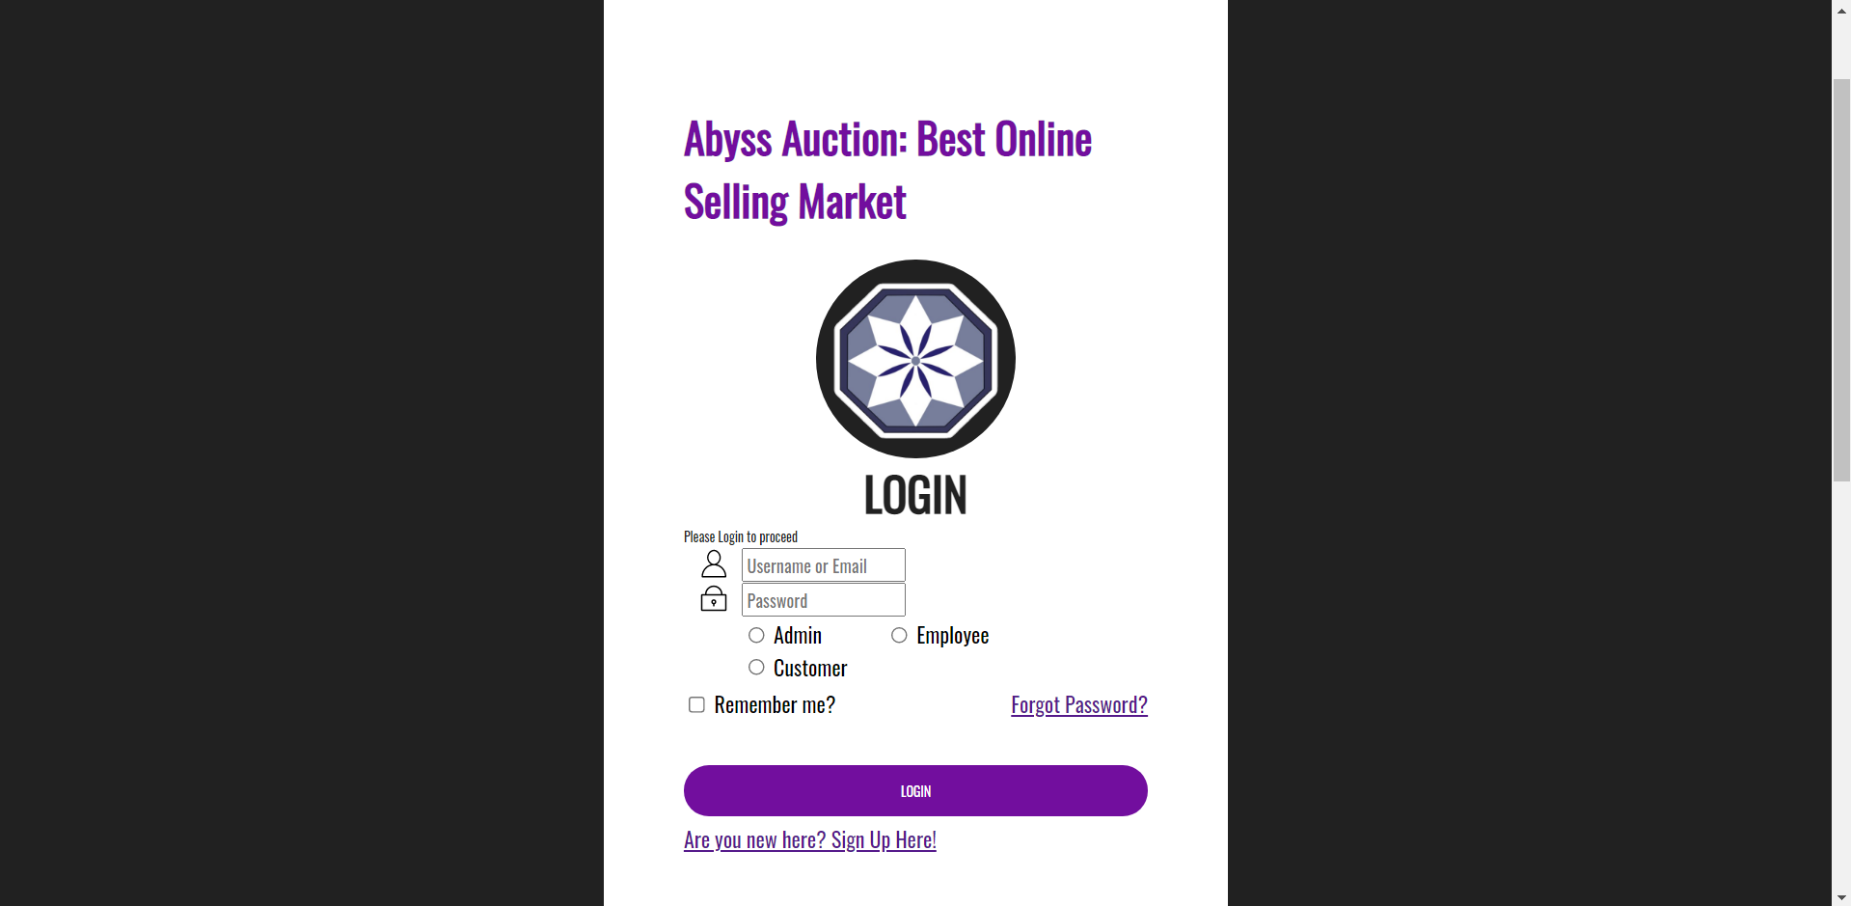
USER INTERFACE DESIGN:Screen Title: LOGIN
ACCESS TABLE
Users to login to this interface.
The e-mail/username , password and roles are either entered by your employee or the client prior to entering the system.
The system verifies the e-mail/username ,password and role and if not, it enters.

Slide 8
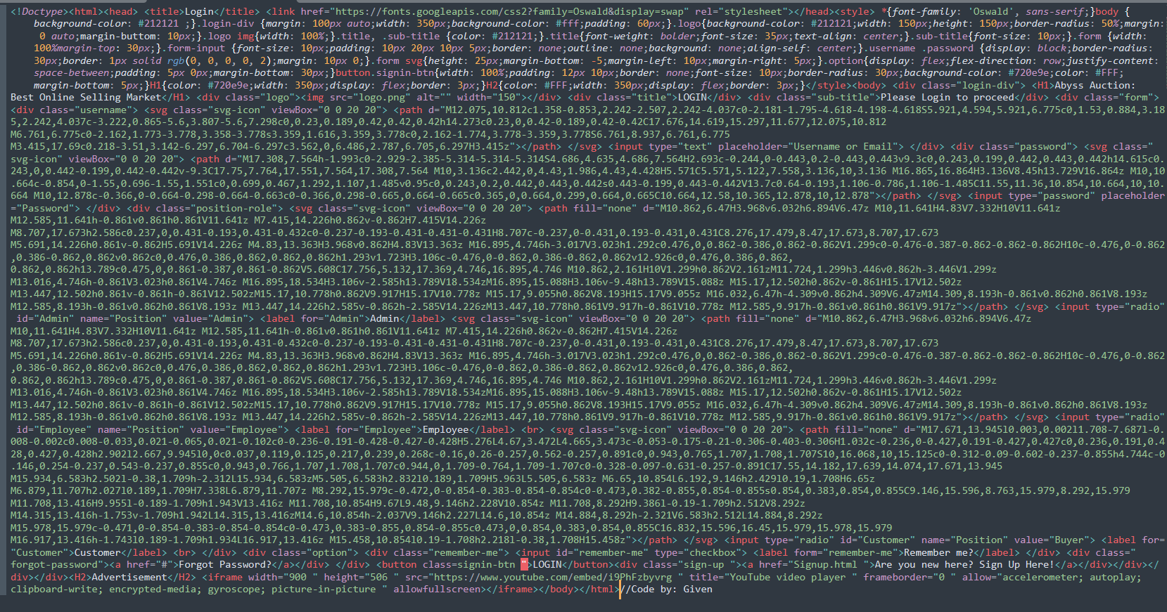
USER INTERFACE DESIGN: CODE

Slide 9
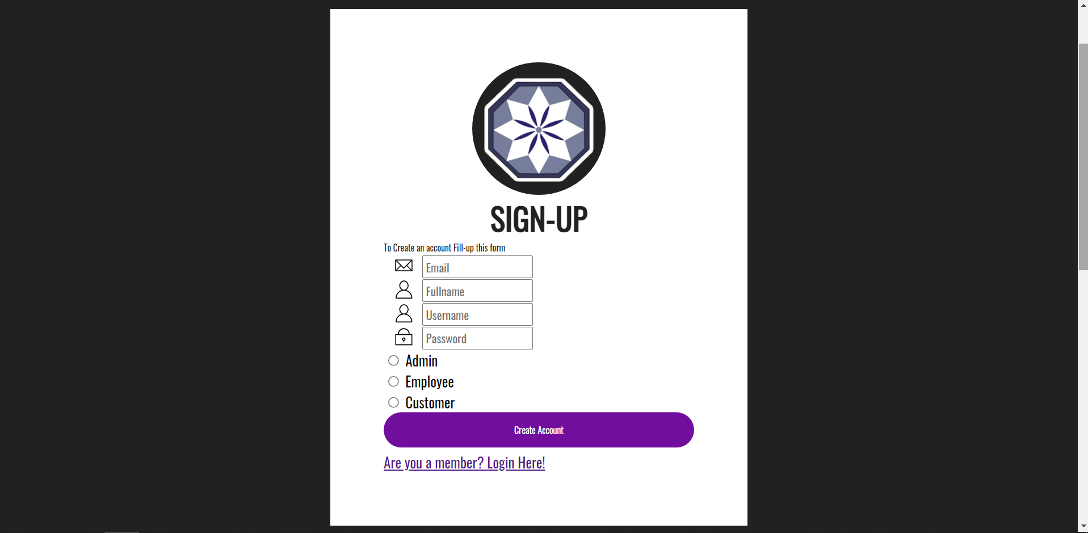
USER INTERFACE DESIGN:Screen Title: SIGN-UP
ACCESS TABLE
This interface is used for new customers or employees to sign up in order to gain access to the system by registering their Email, Username, Password and their desired roles in the system.

Slide 10
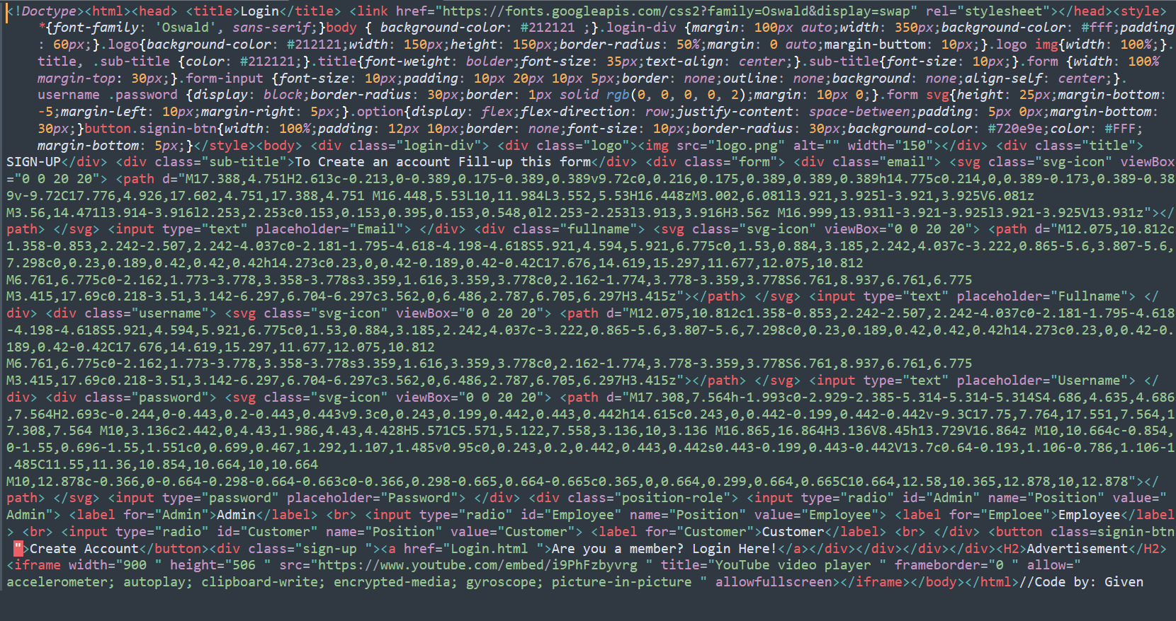
USER INTERFACE DESIGN: CODE

